Slide 1
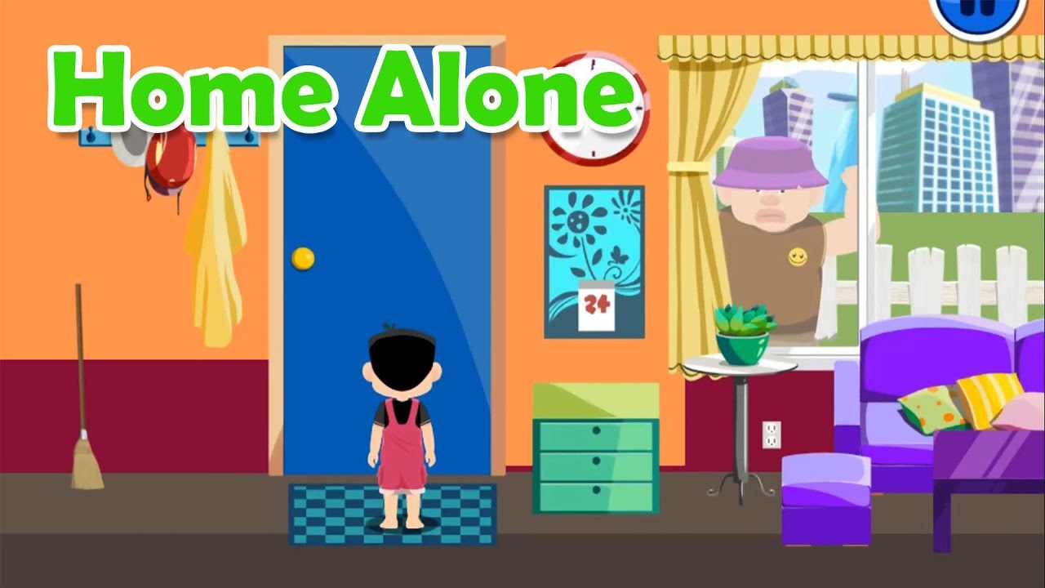

CHILD MONITORING
Notes:
To change the image on this slide, select the picture and delete it. Then click the Pictures icon in the placeholder to insert your own image.

Slide 2
PROBLEM STATEMENT
Construct an Automatic Child Monitoring Device that can help the
Child to stay comfortably at home inspite of being away from the
parents in todays modern generations .
(Assumed child to be 10 to 15 months old.)

Slide 3
Two Content Layout with Table
First bullet point here
Second bullet point here
Third bullet point here
Class | Group A | Group B
Class 1 | 82 | 95
Class 2 | 76 | 88
Class 3 | 84 | 90

Slide 4
Title and Content Layout with SmartArt
Step 1 Title
Step 2 Title
Step 3 Title
Step 4 Title

Slide 5
Case Study

Slide 6
Why then do bystanders call 911 when they see children playing in parks, but not when they see children riding in cars?

Slide 7
To test this hypothesis, we examined whether participants judgments about danger to an unsupervised child vary according to the moral acceptability of the parents reason for leaving the child alone.

Slide 8
If our Hypothesis is correct: 1. children are in more danger when parents deliberately allow them to be unsupervised than when children are left unsupervised by accident. 2. Children are in more danger when a parent leaves for a morally unacceptable reason (e.g., to meet an illicit lover) than for a morally neutral or acceptable reason (e.g., to go to work).

Slide 9
In this experiment we required to read brief vignettes in which a child spends a brief period of time unsupervised. The children’s ages, locations and duration of time unsupervised in each vignette were kept constant.

Slide 10
Basic Five Vignette Types.
Child’s name & age | Location | Minutes alone
Olivia, 10 months | Asleep in the car in a gym’s cool underground parking garage | 15
Cassidy, 2.5 | Home, eating a snack, watching Frozen | 20
Grace, 4 | Playing on ipad in the car, in a shady spot in a library parking lot | 30
Jenny, 6 | A park about a mile from her house | 25
Susie, 8 | Starbucks, one block away from where her mother is | 45

Slide 11
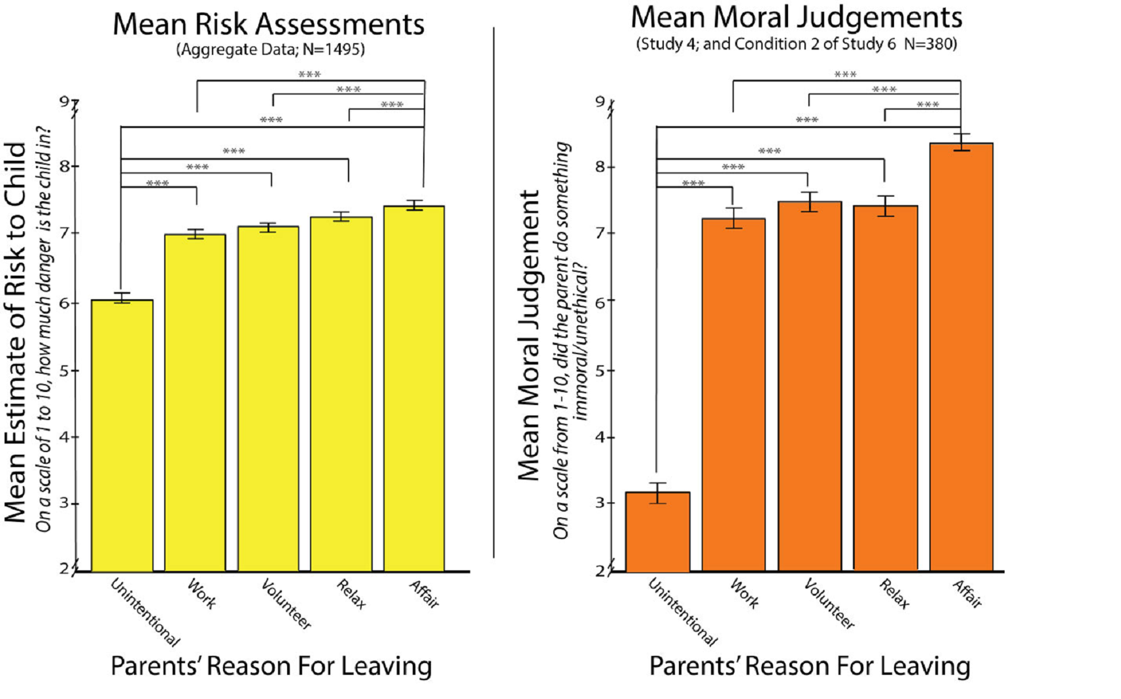

Slide 12
Add a https://www.collabra.org/articles/10.1525/collabra.33/Slide Title - 3

Slide 13
Add a Slide Title - 4

Slide 15
Add a Slide Title - 5

Slide 16
Add a Slide Title - 6

Slide 17
Add a Slide Title - 7

